Slide 1
Covid-19 Cases Prediction Using Machine Learning

Slide 2
What is COVID-19?
Corona Virus disease (COVID-19) is an infectious disease caused by a newly discovered virus, which emerged in Wuhan, China in December of 2019.
Most people infected with the COVID-19 virus will experience mild to moderate respiratory illness and recover without requiring special treatment.
The COVID-19 virus spreads primarily through droplets of saliva or discharge from the nose when an infected person coughs or sneezes, so you might have heard caution to practice respiratory etiquette

Slide 3
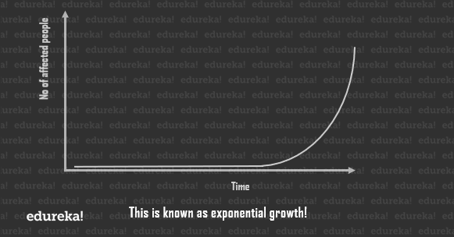
How does a Pandemic Work?
A Pandemic displays a property called exponential growth.
This is how a Pandemic works. The outbreak is fairly unnoticeable in the beginning, then, once it reaches a significant value, the growth to maxima is extremely quick.

Slide 4
Case Study: Analyzing the Outbreak of COVID 19 using Machine Learning Problem Statement
We need a strong model that predicts how the virus could spread across different countries and regions. The goal of this task is to build a model that predicts the spread of the virus in the future.
Tasks to be performed:
Analyzing the present condition in India
Exploring India’s Covid-19 data
Forecasting India’s COVID-19 cases using Linear Regression

Slide 5
WHAT IS MACHINE LEARNING?
Machine learning is a branch of Artificial Intelligence (AI) and computer science which focuses on the use of data and algorithms to imitate the way that humans learn, gradually improving its accuracy.
Machine learning is an important component of the growing field of data science. Through the use of statistical methods, algorithms are trained to make classifications or predictions, uncovering key insights within data mining projects. These insights subsequently drive decision making within applications and businesses, ideally impacting key growth metrics.

Slide 6
Libraries Used
Before we begin with the model, let’s first import the libraries that we need. This is Step 0. In here we import a few important libraries that we shall use throughout the model.
Pandas is an extremely fast and flexible data analysis and manipulation tool and allows you to allow you to store and manipulate tabular data.
We also import visualization libraries such as matplotlib, seaborn
NumPy is a library used for working with arrays. It also has functions for working in domain of linear algebra, Fourier transform, and matrices
Datetime module supplies classes to work with date and time

Slide 7
Model used – linear regression
Linear regression is one of the easiest and most popular Machine Learning algorithms. It is a statistical method that is used for predictive analysis. Linear regression makes predictions for continuous/real or numeric variables such as sales, salary, age, product price etc.
Regression model such as Linear and Multiple Linear Regression techniques are applied to the data set to visualize the trend of the affected cases.

Slide 8
Some glimpses of our code

Slide 9
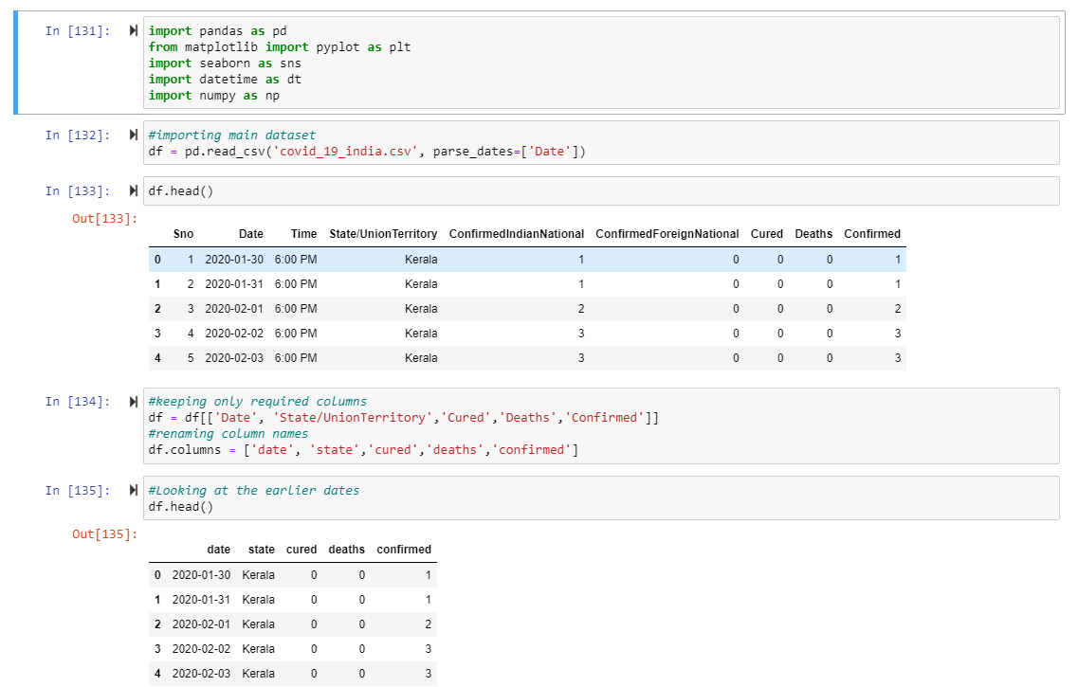

Slide 10
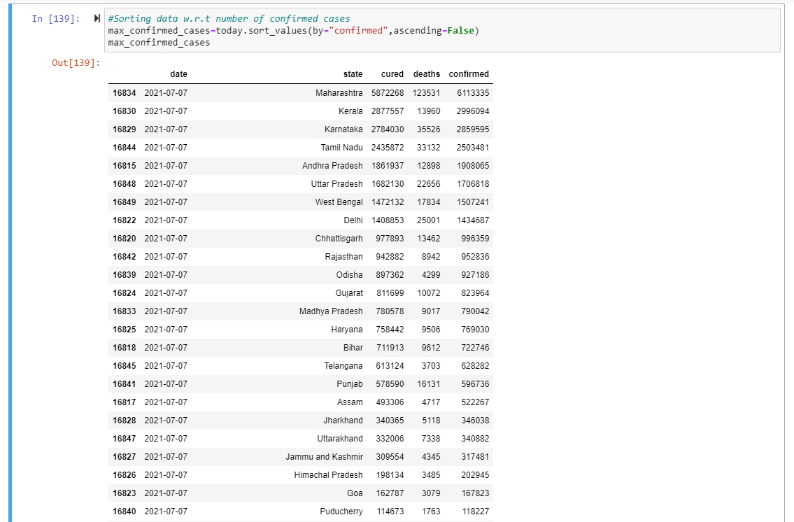

Slide 11
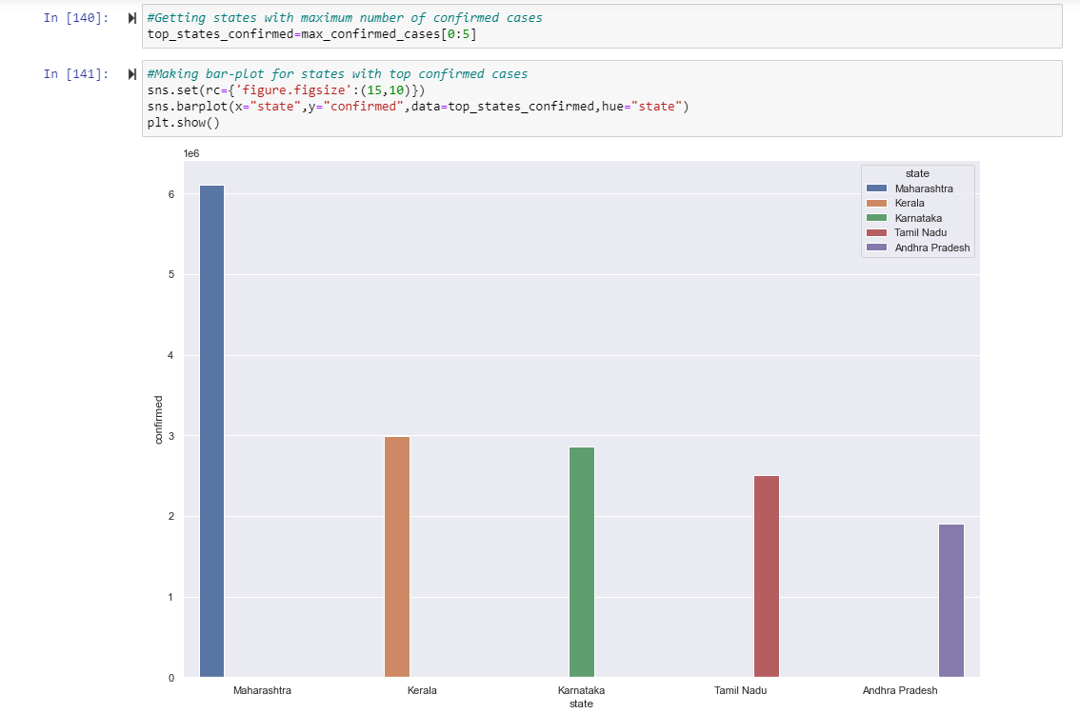

Slide 12
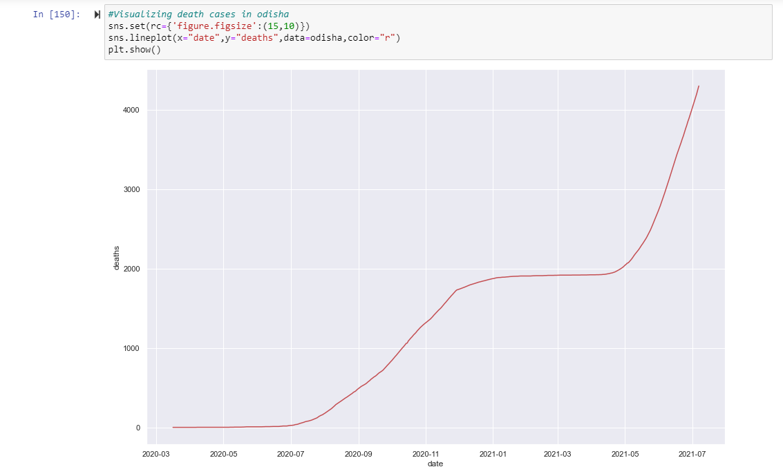

Slide 13
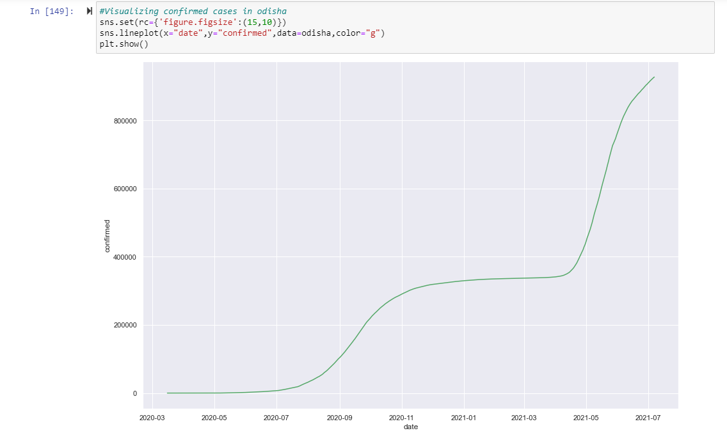

Slide 14
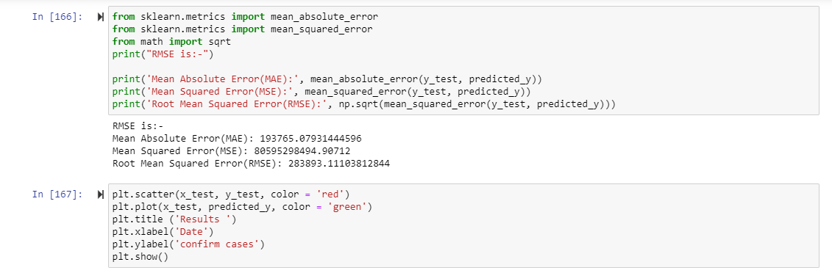

Slide 15
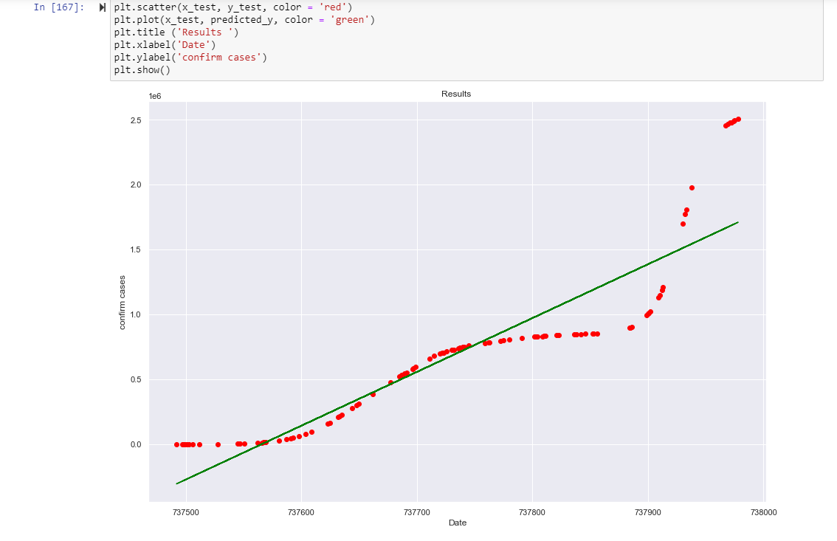

Slide 16
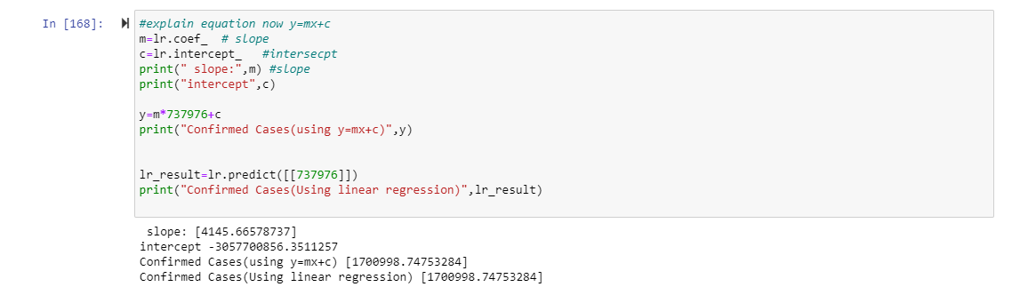

Slide 17
Thank You
By : Asutosh Patra and Animesh Singh

